Slide 1


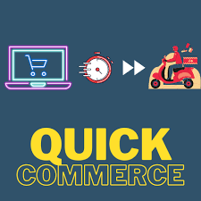


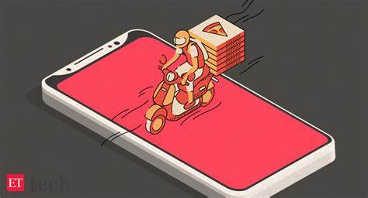

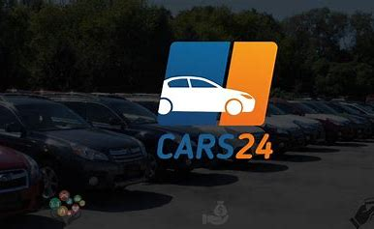
Product centric Agile Development

Slide 2
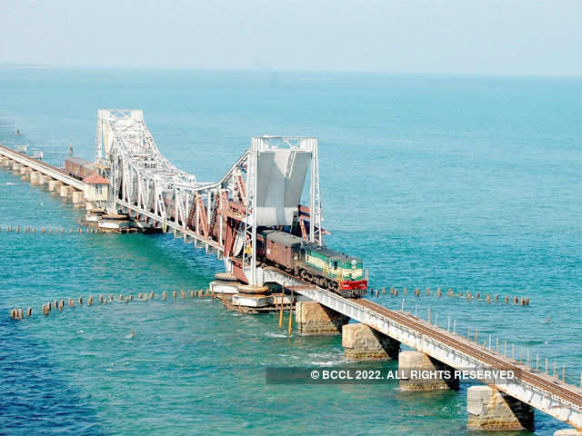



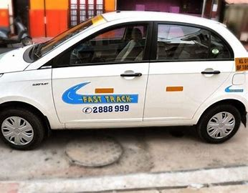
Traditional project based initiatives .. Fixed scope & business benefits ..

Slide 3
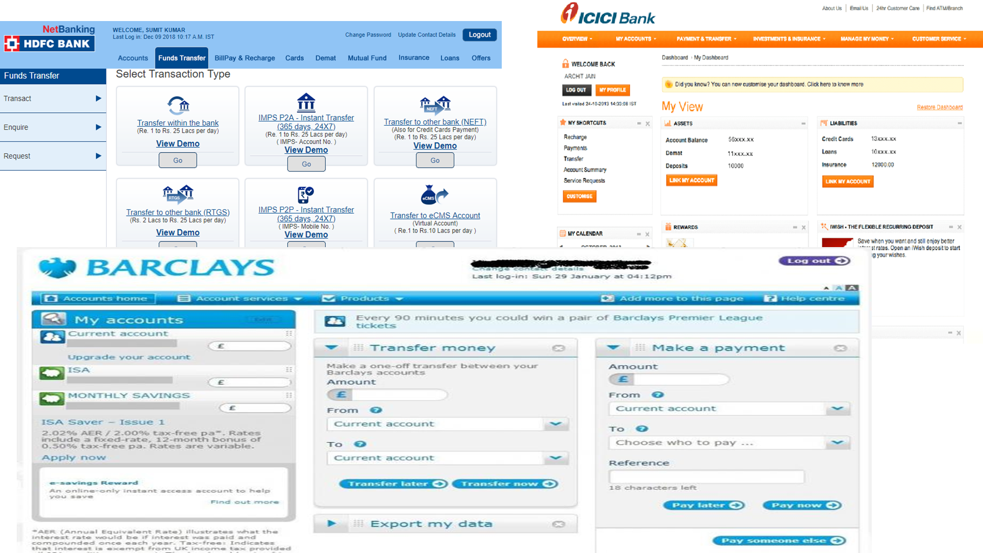
Some of the usecases could be similar across industry ..

Slide 4
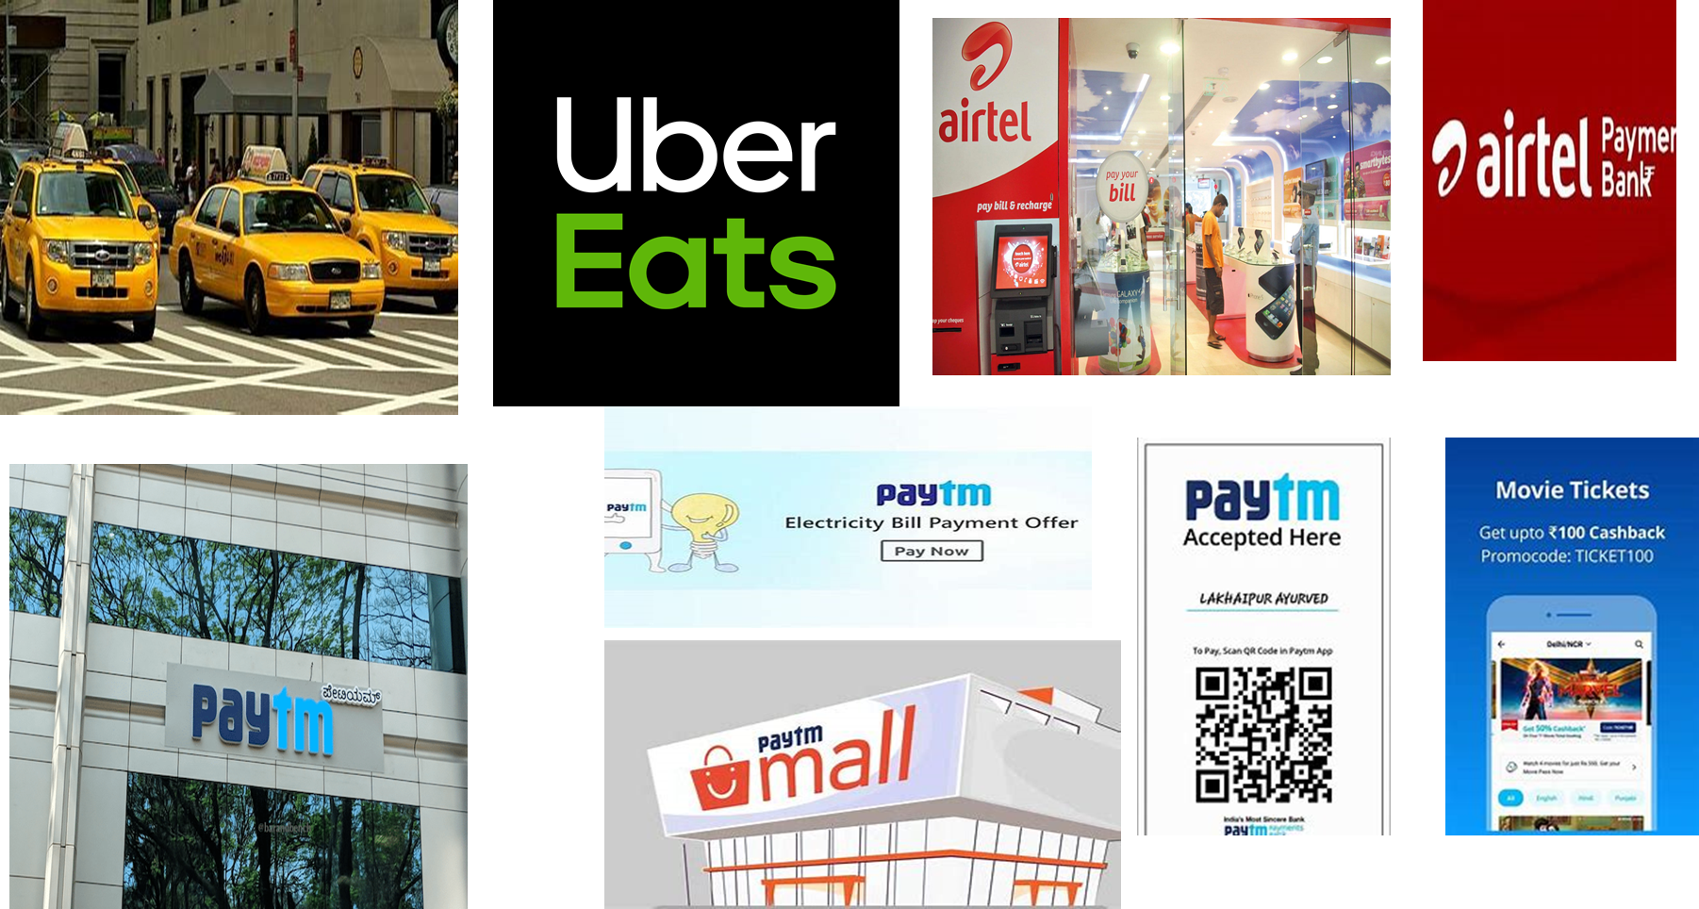
With New business models .. Disrupting the whole ecosystem ..

Slide 5
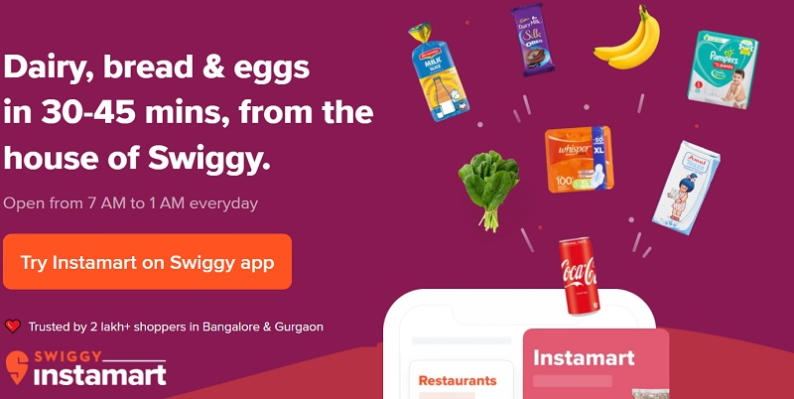

With continuous evolution of newer business models …
Swiggy getting into Quick commerce space ..

Slide 6
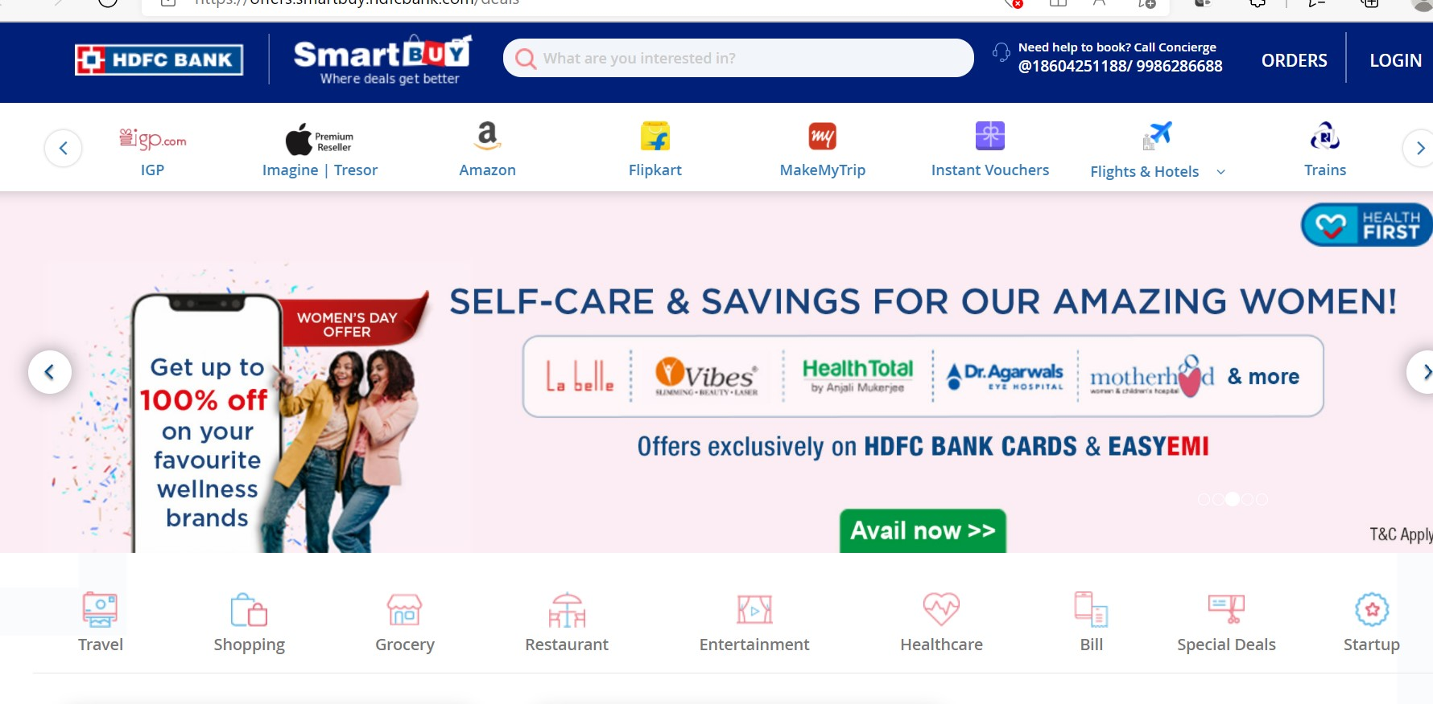

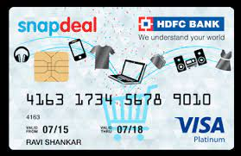

New ways of co-branded business ..
Mainline players getting into new business areas by co-branding, expansion

Slide 7
Project Vs Product centric approach?
Oppurtunity landscape
Probable Business cases
Exploration based – creating new product or services
Shifting engineering landcape
How opportunitie are identified ?
Exact market needs
Competing env in market place
Monolithic
Microservices
Project staffing
Tech savvy workforce for ADM/ Ops/ project based roles
TechnicaL Excellence, Full stack, Agile mind-set, product centric roles
Waterfall / Iterative / Large teams
Agile / XP / DevOps
Project measures / KPIs
On time / On Budget /Benefits realization
Value based – CSAT
Fail fast
Lean Agile Delivery Models
Funding
Annual budgets
Incremental budgets – frequent checkpoints

Slide 8
Key considerations for product centric initiatives
IT becoming close partner to rest of business
Iterative / incremental Budgeting & investment approach
Agile delivery models
Mapping Business capabilities, product lines, products
Identify Product centric roles
Establish Community of Practice
Enable Product centric skills

Slide 9
New roles for product centric ecosystem ..
Portfolio Leader
Program Manager
Project Manager
Scrum Master
Capability Leader
Product Manager
Functional Leader
Product Owner
Engineering Manager
DevOps Architect
Site reliability engineers
Automation expert

Slide 10
Typical Org structure for Product centric org
Infra / IT capability leader
IT Directors
Program Manager
RTE / Scrum Masters
Technology / IT Leadership
(CIO, CTO)
Operations Capability leader
Product Line Directors
Product Managers
Product Owners
Business Capability leader 1
Product Line Directors
Product Managers
Product owners
Business Org (CMO, CDO etc)
Business Capability leader 2
Product Line Directors
Product Managers
Product owners

Slide 11
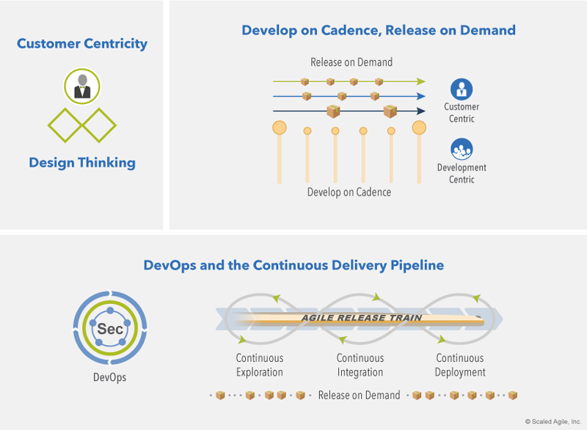
Bringing Agility as part of overall Development … key dimensions

Slide 12
Customer centricity – key focus on end customers
Customer Centricity
Understand needs
Think / feel like customer
Build whole product solitions
Create customer life time value
Long term relationships
Focus on Customer

Slide 13
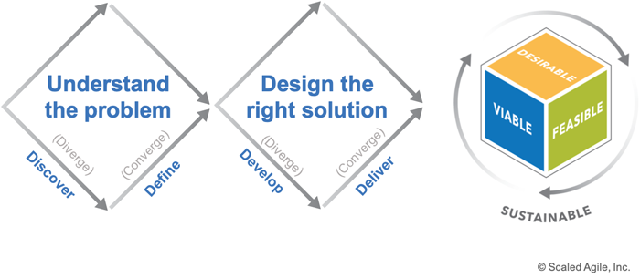
Design thinking is integral to Customer centricity …

Slide 14
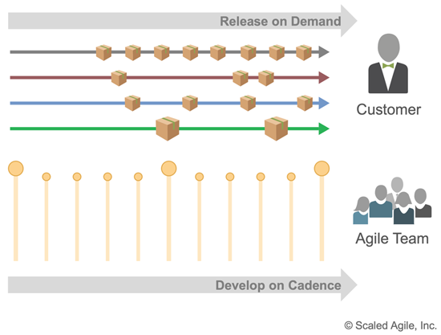
Develop on Cadence, Release on Demand

Slide 15
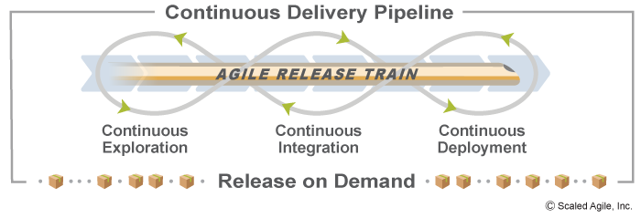
Continuous Delivery pipeline
Continuous Exploration
Fosters innovation
Design thinking – to explore markets & customer needs
Define Vision, Roadmap, features
Continuous Integration
Building quality intoDevelopment
All work are version controlled
Validated in Staging env
Continous deployment
Captures processes associated with moving solution through staging to prod envs
Release on demand
Ability to make value available to customers at once or ad hoc
Based on market & business needs

Slide 16
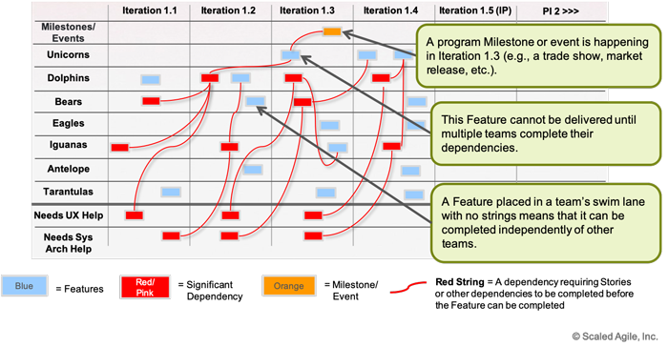
Continuous delivery - Release on demand .. Leveraging Program Boards

Slide 17
Appendix

Slide 18
